Slide 1
Hybrid Identity

Slide 2
Abstract and learning objectives
In this whiteboard design session, you will learn how to implement different components of a Hybrid Identity solution that integrates an Active Directory forest with an Azure Active Directory tenant and leverages a number of Azure Active Directory features, including:
Passthrough authentication with Seamless Single Sign-On
Multi-Factor Authentication
Self-Service Password Reset
Azure AD Password Protection
Hybrid Azure AD join
Windows Hello for Business
Microsoft Intune automatic enrollment
Azure AD Conditional Access
Azure AD Application Proxy
Azure AD B2B
Azure AD B2C

Slide 3
Step 1: Review the customer case study
Outcome
Analyze your customer needs
Timeframe
15 minutes
Notes:
Inform students about the purpose of the first step of the design session

Slide 4
Customer situation : Contoso
Contoso is a medium size financial services company with its headquarters in New York and a branch office in San Francisco. It is currently operating entirely on-premises, with majority of its infrastructure running on the Windows platform.
Contoso is facing some challenges related to increased mobility of its workforce. In particular, in order to drive down its office space costs, Contoso management is considering implementing a flexible work arrangement policy which would allow its employees to work on designated days from home, using either corporate- and employee-owned devices. However, the Contoso's Information Security team expressed concerns about insufficient controls that would prevent access from unauthorized or non-compliant systems. In addition, there are concerns regarding using traditional VPN technologies or DirectAccess, which tend to provide excessive access to on-promises infrastructure.

Slide 5
Current environment: Contoso
Contoso has a single domain Active Directory forest which was implemented over a decade ago. The domain was assigned a non-routable DNS name contoso.local. While the Directory Services team considered renaming the domain, this has never been implemented due to potential negative implications of such change. Contoso does own a publicly routable DNS domain name contoso.com.
Contoso has recently upgraded its Active Directory environment to Windows Server 2016 and it is in the process of migrating its desktops from Windows 7 to Windows 10. Majority of servers are running either Windows Server 2012 R2 or Windows Server 2016.

Slide 6
Customer objectives
Contoso is exploring the option of transitioning its operations into a more Internet-open model which would facilitate support for mobile workforce and integration with business partners, while, at the same time, support current security and manageability controls. Given its current environment, which is heavily dependent on Active Directory and undergoes migration to Windows 10 devices, Contoso intends to evaluate Azure Active Directory and Microsoft Intune as potential identity and management components of the target design.
The identity component of the target design should facilitate step-up authentication and per-application permissions based not only on the properties of users' accounts but also on the state of these users' devices. To maximize security, Contoso wants to minimize or even eliminate persistent assignments of privileged roles for identity management, but, at the same time, such arrangement must account for break-glass scenarios, allowing for a non-gated emergency use of privileged accounts. For obvious reasons, such accounts needs to be closely monitored and audited.

Slide 7
Customer objectives (continued)
Another Information Security concern is accidental exposure of users passwords. Contoso would like to minimize their use in lieu of more secure authentication methods. In situations where passwords are required, users should also be able to both change and reset them without having to rely on HelpDesk services. At the same time, any on-premises Active Directory user account restrictions, such as allowed sign-in hours must be honored. Similarly, the existing Active Directory password policies must apply, although the head of Information Security would like to enhance them by preventing use of common terms within password values.
Besides enhancing self-service user capabilities, Contoso wants to optimize end-user experience, especially in environment where users might be using several different devices. The user-defined settings, such as accessibility or app customization should be consistent across all devices.

Slide 8
Customer objectives (continued)
In addition, Contoso needs to expand its customer base through partnership with other financial institutions and providing direct access to its services to external clients. As part of this effort, Contoso established business relationship with Fabrikam, which manages an extensive portfolio of mortgage related products. Contoso intends to provide Fabrikam with access to its internal Windows Integrated Authentication-based web applications that could be integrated with the existing Fabrikam's products. The access methodology needs to account for the fact that in recent years, Fabrikam has modernized its technology and moved its operations almost entirely to Microsoft Azure.
To facilitate the expansion of customer base, Contoso started developing a number of applications intended to be available both via web and from mobile devices. Historically, such applications were hosted in on-premises data centers and relied on an internally developed identity management product. Going forward, Contoso wants to minimize the effort managing customer identities.

Slide 9
Customer objectives (continued)
The management team of Contoso, including its CIO, Andrew Cross emphasized the need for resiliency and Service Level Agreements associated with each of the identity-related components that are part of the target design. At the same time, they are also interested in minimizing additional infrastructure requirements to implement the design.

Slide 10
Customer needs
Remote users must be able to sign in to their devices by using their Active Directory credentials.
Existing Active Directory user sign-in hours and password policies must be preserved (although allowed password values could be further restricted).
User sing-in experience should be simplified by minimizing the number of sign-in prompts and limiting the use passwords in lieu of more secure authentication methods.
Users device configuration should be simplified by leveraging a mobile device management solution and roaming user-specific settings across multiple devices.
Control access of users to applications and resources by relying on a combination of multiple conditions, including users group membership, state of the users devices, and dynamically evaluated risk based on heuristics and globally collected security related telemetry.

Slide 11
Customer needs (continued)
Users must be allowed to reset their own passwords.
Designated users should be able to temporarily elevate their privileges to manage other user accounts. All elevation events must be edited.
Contoso remote users must be able to access on-premises Windows Integrated Authentication-based applications.
Fabrikam users must be able to access on-premises Windows Integrated Authentication-based applications.
Commercial applications developed by Contoso programmers must be made available to external customers with minimum overhead associated with identity management.
Resiliency must be maximized whenever possible.
Infrastructure requirements must be minimized

Slide 12
Customer objections
Our Active Directory domain is using a non-routable domain name. We cannot risk renaming it in order to implement single sign-on with Azure Active Directory.
We have heard that it is not possible to run simultaneously multiple instance of Azure AD Connect. All identity services components in our environment must provide resiliency and support failover.
If we decide to integrate our Active Directory environment with Azure Active Directory, this must be performed in stages. This is likely to be complex, considering that users in each stage would be members of different Active Directory groups and their accounts might reside in different Active Directory organizational units.

Slide 13
Customer objections (continued)
Synchronizing our Active Directory accounts with Azure AD accounts makes the former vulnerable to malicious or accidental lockouts that affect the latter. This would effectively expose our on-premises environment to external attacks.
A number of critical web applications running in our on-premises environment rely on Kerberos-based Windows Integrated Authentication. Microsoft states that Azure Active Directory does not support Kerberos. Doesn't this mean that remote users authenticating to Azure Active Directory and our business partners will not be able to properly authenticate and access these applications?

Slide 14
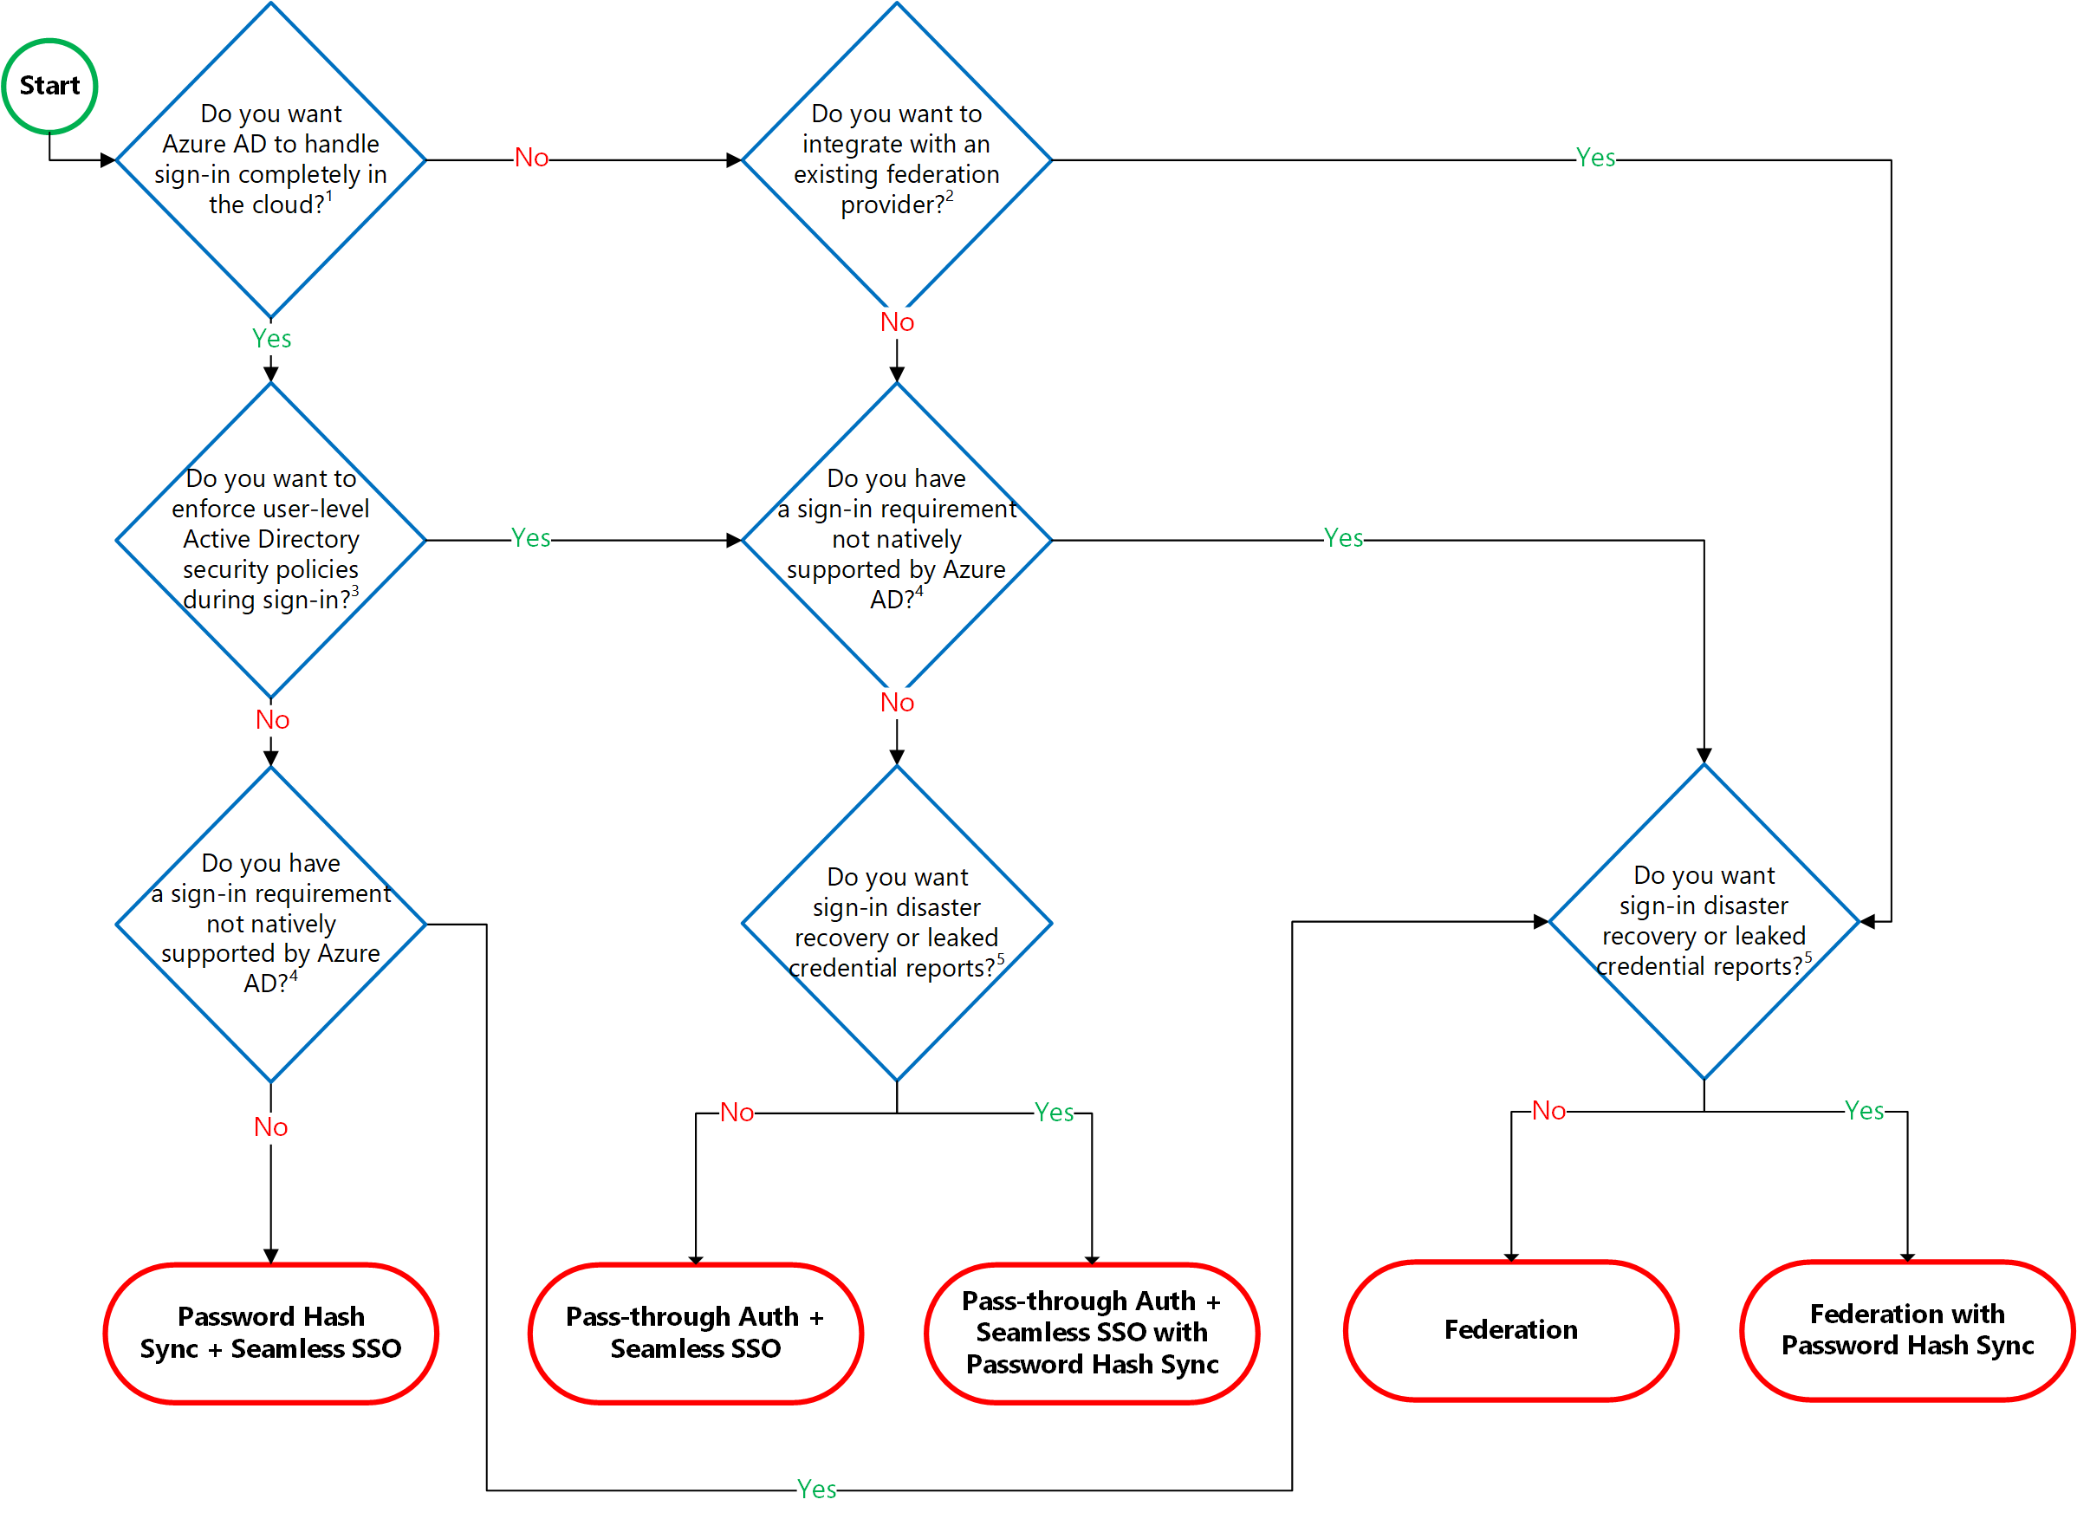
Common scenarios
Hybrid identity authentication decision workflow:

Slide 15
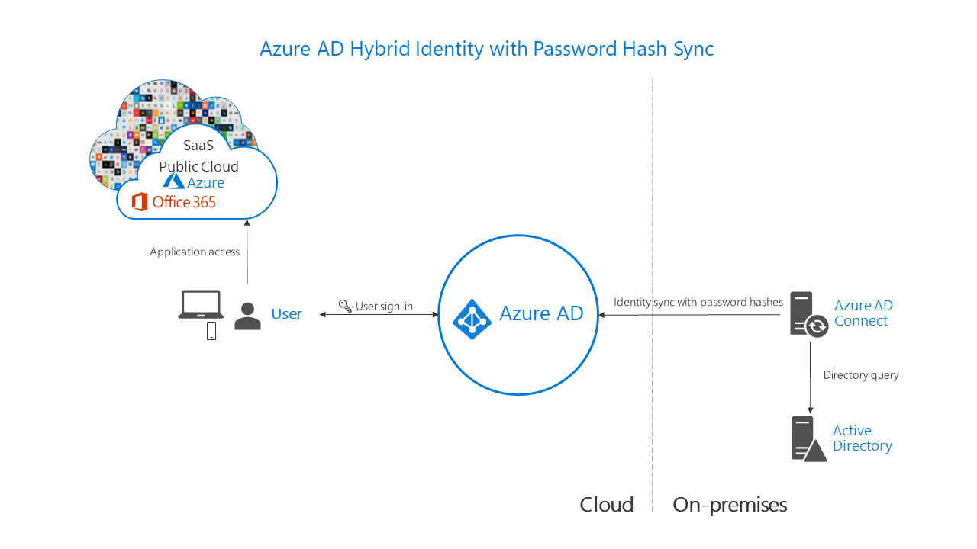
Common scenarios
Azure AD hybrid identity password-hash synchronization

Slide 16
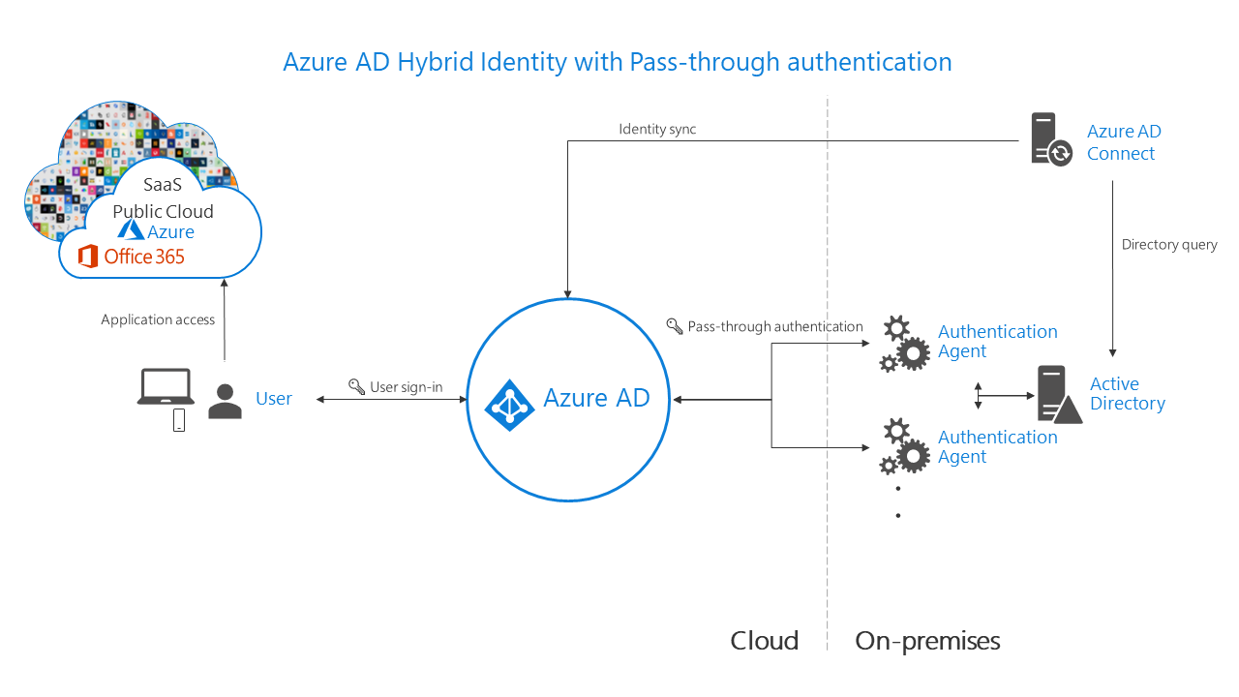
Common scenarios
Azure AD hybrid identity pass-through authentication

Slide 17
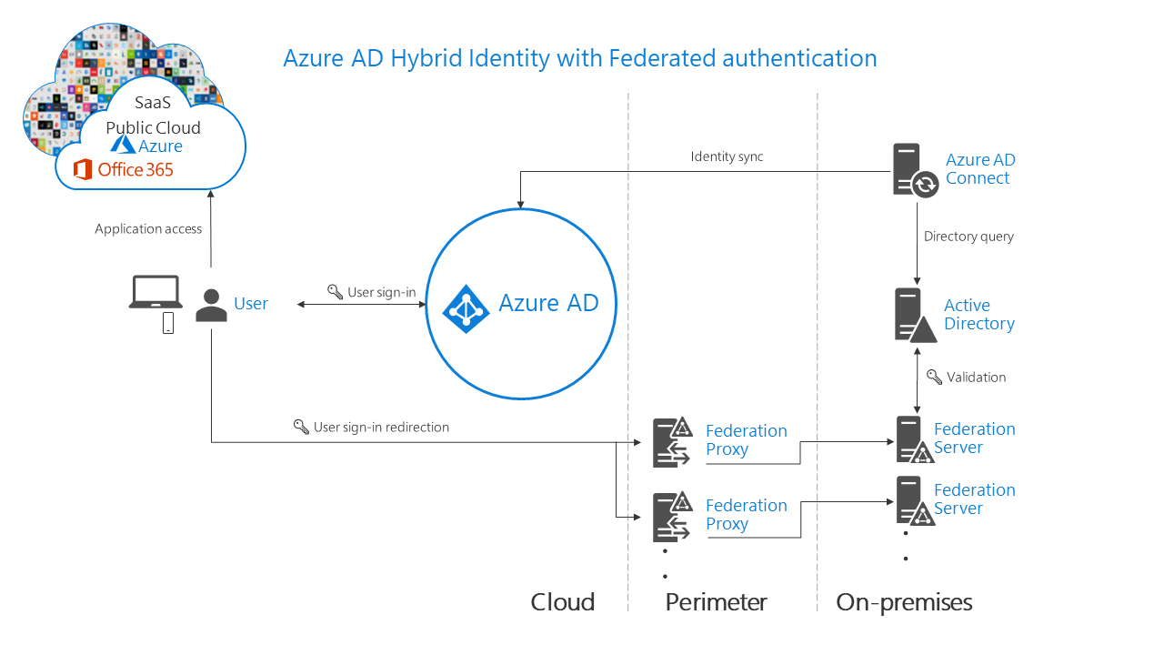
Common scenarios
Azure AD hybrid identity federation

Slide 18
Requirements
Remote users must be able to sign in to their devices by using their Active Directory credentials.
Existing Active Directory user sign-in hours and password policies must be preserved (although allowed password values could be further restricted).
User sing-in experience should be simplified by minimizing the number of sign-in prompts and limiting the use passwords in lieu of more secure authentication methods.
Users device configuration should be simplified by leveraging a mobile device management solution and roaming user-specific settings across multiple devices.
Control access of users to applications and resources by relying on a combination of multiple conditions, including users group membership, state of the users devices, and dynamically evaluated risk based on heuristics and globally collected security related telemetry.

Slide 19
Requirements (continued)
Users must be allowed to reset their own passwords.
Designated users should be able to temporarily elevate their privileges to manage other user accounts. All elevation events must be edited.
Contoso remote users must be able to access on-premises Windows Integrated Authentication-based applications.
Fabrikam users must be able to access on-premises Windows Integrated Authentication-based applications.
Commercial applications developed by Contoso programmers must be made available to external customers with minimum overhead associated with identity management.
Resiliency must be maximized whenever possible.
Infrastructure requirements must be minimized

Slide 20
Step 2: Design the solution
Outcome
Design a solution and prepare to present the solution to the target customer audience in a 15-minute chalk-talk format.
Timeframe
60 minutes
Business needs (10 minutes) | Respond to questions outlined in your guide and list the answers on a flipchart
Design (35 minutes) | Design a solution for as many of the stated requirements as time allows. Show the solution on a flipchart
Prepare (15 minutes) | Identify any customer needs that are not addressed with the proposed solution Identify the benefits of your solution Determine how you will respond to the customer’s objections Prepare for a 15-minute presentation to the customer

Slide 21
Step 3: Present the solution
Outcome
Present a solution to the target customer in a 15-minute chalk-talk format
Timeframe
30 minutes (15 minutes for each team to present and receive feedback)
Directions
Pair with another table
One table is the Microsoft team and the other table is the customer
The Microsoft team presents their proposed solution to the customer
The customer asks one of the objections from the list of objections in the case study
The Microsoft team responds to the objection
The customer team gives feedback to the Microsoft team

Slide 22
Wrap-up
Outcome
Identify the preferred solution for the case study
Identify solutions designed by other teams
Timeframe
15 minutes

Slide 23
Preferred target audience
Andy Cross, CIO
VP of IT Operations:
Reports to CIO, manages operational aspects of IT infrastructure, including its Directory Services platform
Lead engineer of the Directory Services team
Head of Information Security
Business Development Manager (BDM) and Application Sponsor (CFO):
Fund projects & apps
Interested in exploring the functionality offered by public cloud

Slide 24
Preferred solution (Azure AD)
The preferred solution relies on pass-through authentication with seamless single sign-on to provide integration between on-premises Active Directory environment and an Azure AD tenant. That integration, implemented by virtue of installing Azure AD Connect on an on-premises Windows Server with direct connectivity to Active Direct domain controllers and Azure AD, drives a number of other configuration choices, including Hybrid Azure AD join, Self-Service Password Reset with password writeback, Azure AD Password Protection for Windows Server Active Directory, Azure AD Multi-Factor Authentication, Azure AD Privileged Identity Management, Azure AD Conditional Access with Azure AD Identity Protection-based risk assessment, as well as Azure AD Application Proxy.
Hybrid Azure AD join will additionally allow implementing Hybrid Key trust-based Windows Hello for Business on Windows 10 domain member computers, although this will require additional infrastructure changes, including installation of an internal Certification Authority.

Slide 25
Preferred solution (Azure AD B2B and B2C)
In order to provide access to on-premises applications to business partners, Contoso will leverage Azure AD B2B capabilities and Azure AD Application Proxy. For in-house developed customer apps, Contoso will implement an Azure AD B2C tenant.

Slide 26
Preferred solution (prerequisites)
Contoso will provision a new Azure Active Directory tenant with a custom, publicly routable domain name and use Azure AD Connect in order to integrate it with on-premises Active Directory environment.
Contoso will purchase Azure AD Premium P2 licenses for its users, in order to provide the ability to implement:
Azure AD Privileged Identity Management
Azure AD Identity Protection
Conditional Access (available starting with Azure AD Premium P1)
Multi-Factor Authentication (available starting with Azure AD Premium P1)
Azure AD Application Proxy (available starting with Azure AD Premium P1)
Password Protection for Windows Server Active Directory (available starting with Azure AD Premium P1)
Self-service password reset/change/unlock with on-premises writeback (available starting with Azure AD Premium P1)

Slide 27
Preferred solution (authentication method)
In order to minimize infrastructure footprint required for integration, streamline user experience, and, at the same time, ensure that any on-premises Active Directory user account restrictions, such as allowed sign-in hours must be honored, the proposed solution leverages pass-through authentication with seamless single sign-on (SSO).
The need for preserving on-premises Active Directory user account restrictions eliminates the possibility of relying exclusively on Azure AD password hash synchronization
Federated authentication allows for enforcing on-premises AD password policies and restrictions when authenticating Azure AD accounts, but it has significantly larger infrastructure footprint

Slide 28
Preferred solution (Windows Hello for Business)
In order to minimize the use of passwords, Contoso will implement Windows Hello for Business. Windows Hello for Business replaces passwords with strong two-factor authentication on Windows 10 devices. This authentication consists of a new type of user credential that is tied to a device and uses a biometric or PIN.
Windows Hello for Business lets user authenticate to an Active Directory or Azure Active Directory account. In hybrid deployments, Windows Hello for Business can leverage Hybrid Azure AD joined computers, so Contoso will start by configuring Hybrid Azure AD join for its on-premises computers.
Considering that Contoso is not planning on using federated authentication, this implies the choice of Windows Hello for Business hybrid key trust deployment model.

Slide 29
Implementing a hybrid identity solution
Azure AD tenant
In order to implement the Hybrid Identity model, Contoso will create an Azure AD tenant and purchase licenses Enterprise Mobility + Security E5 licenses for its users. To account for the integration and single sign-on requirements, Contoso will also leverage its ownership of a publicly routable DNS domain name and assign it as a verified, custom DNS domain name to the newly provisioned Azure AD tenant.

Slide 30
Implementing a hybrid identity solution
Active Directory configuration
UPN suffix
The publicly routable DNS domain name will be assigned as the suffix of the userPrincipalName attribute of all Active Directory user accounts to be integrated with Azure AD.
Recycle Bin
It is recommended that you enable the AD Recycle Bin feature for your on-premises Active Directory domains which are synchronized to Azure AD. If you accidentally delete an on-premises AD user object and restore it using the feature, Azure AD will restores the corresponding Azure AD user object.
If you do not have on-premises AD Recycle Bin feature enabled, you may be required to create an AD user object to replace the deleted object. If Azure AD Connect Synchronization Service is configured to use system-generated AD attribute (such as ObjectGuid) for the Source Anchor attribute, the newly created AD user object will not have the same Source Anchor value as the deleted AD user object. When the newly created AD user object is synchronized to Azure AD, Azure AD creates a new Azure AD user object instead of restoring the soft-deleted Azure AD user object.

Slide 31
Implementing a hybrid identity solution
Azure AD Connect configuration
Authentication method
For pass-through authentication, you need to install at least one or more (three are recommended) lightweight Authentication Agents on your on-premises computers running Windows Servers 2012 R2 or newer with TLS 1.2 enabled. The computers hosting the agents must have direct access to Active Directory domain controllers and outbound access to internet. The first agent is installed automatically on the computer hosting Azure AD Connect once you choose to use pass-through authentication. To install additional agents, you can download their setup files from the Pass-through authentication blade (accessible via Azure AD Connect blade in the Azure Active Directory section of the Azure portal). Installation can be performed interactively (you will be prompted to sign in with an account that has been assigned the Azure AD Global Administrator role) or via an unattended deployment script.

Slide 32
Implementing a hybrid identity solution
Azure AD Connect configuration
Filtering
Azure AD Connect offers a number of different filtering options that determine the scope of synchronized Active Directory objects. While organizational unit based filtering is the most straightforward to configure option, the scope can be based on a value of individual Active Directory attributes, which offers object-level granularity.
Configuring attribute-based filtering relies on declarative provisioning, which is configurable by using Synchronization Rules Editor, included in the installation of Azure AD Connect. It can be applied when importing objects from Active Directory into to the metaverse (inbound) or when exporting objects from the metaverse to Azure AD (outbound). The recommended approach involves inbound filtering because this is easiest to maintain. Outbound fitlering might be required in some scenarios, such as, for example, joining objects from more than one Active Directory forest before applying the filtering logic.

Slide 33
Implementing a hybrid identity solution
Azure AD Connect configuration
Filtering
In inbound filtering, the scope determines which objects to synchronize or not synchronize. The scope has a group and a clause to determine when a sync rule is in scope. A group contains one or many clauses. There is a logical AND between multiple clauses, and a logical OR between multiple groups. Objects which are supposed to be synchronized to Azure AD must have the metaverse attribute cloudFiltered not set to a value to be synchronized. If this attribute's value is set to TRUE, then the object is not synchronized.
Contoso will use a combination of the organizational unit-based filtering and the positive filtering based on the value of the userPrincipalName attribute. In particular, user objects to be synchronized will need to have the domain suffix portion of their userPrincipalName attribute match the custom, verified DNS domain name of the Azure AD tenant. This value can be set individually on per user object level as part of staged implementation of the proposed Hybrid Identity solution.

Slide 34
Implementing a hybrid identity solution
Azure AD Conditional Access
A Conditional Access policy is configurable directly from the Azure portal and is intended for granting or blocking access to Azure AD integrated resources based on:
All users, a specific user, member of a group, or assigned role
Specific cloud application being accessed
Device platform
Device state or compliance
Network location or geo-located IP address
Client applications
Sign-in risk (Requires Identity Protection)
Hybrid Azure AD joined device
Approved client application
Other options include stepping up authentication by enforcing Multi-Factor Authentication and applying session-level (rather than gated) restrictions.

Slide 35
Implementing a hybrid identity solution
Azure AD Multi-Factor Authentication
Implementing Azure AD Multi-Factor Authentication involves three configuration steps:
configuring the MFA registration method
configuring the MFA authentication method
configuring scenarios in which MFA is required

Slide 36
Implementing a hybrid identity solution
Azure AD Multi-Factor Authentication : registration
Customers must determine how users will register their authentication methods. This can be accomplished by using Conditional Access, since this approach offers more flexibility. Conditional Access policies enforce registration, requiring unregistered users to complete registration at first sign-in. While it is possible to enable Multi-Factor Authentication by modifying the user state, this effectively forces users to perform two-step verification every time they sign in and overrides Conditional Access policies. However, there are scenarios in which this approach might be preferred or required. It is, for example, necessary, if the customer's current licensing arrangements do not include Conditional Access.

Slide 37
Implementing a hybrid identity solution
Azure AD Multi-Factor Authentication : registration
Additionally, with Azure AD Premium P2 licensing, customers have the option of leveraging Azure AD Identity Protection to further enhance MFA capabilities by implementing an automatic MFA registration policy, as well as incorporating automated risk detection into MFA-based Conditional Access policies. Creating an MFA registration policy will prompt users to register the next time they sign in interactively. Conditional Access policies can be configured to force password changes when there is a threat of compromised identity or require MFA when a sign-in is deemed risky in response to detection of such events as:
Leaked credentials
Sign-ins from anonymous IP addresses
Impossible travel to atypical locations
Sign-ins from unfamiliar locations
Sign-ins from infected devices
Sign-ins from IP addresses with suspicious activities

Slide 38
Implementing a hybrid identity solution
Azure AD Multi-Factor Authentication : authentication
Customers also need to choose the authentication methods that they want to make available for users. It is important to allow more than a single authentication method so that users have a backup method available in case their primary method is unavailable. The methods include:
Notification through mobile app
Verification code from mobile app
Call to phone
Text message to phone

Slide 39
Implementing a hybrid identity solution
Azure AD Self-Service Password Reset (SSPR) and password writeback:
SSPR allows users to reset their password in a secure way using the some of the same methods they use for Azure AD Multi-Factor Authentication (there are a few additional options not available with MFA). Enabling SSPR requires selecting at least one of the following options for the authentication methods (it is recommended to choose two or more authentication methods so provide users with more flexibility):
Mobile app notification
Mobile app code
Email
Mobile phone
Office phone
Security questions
Customers can enable password writeback by using Azure AD Connect, which allows users to reset passwords of their Active Directory accounts by leveraging Azure AD Self-Service Password Reset.

Slide 40
Implementing a hybrid identity solution
Azure AD password protection for Windows Server Active Directory
Azure AD Password Protection for Windows Server Active Directory allows you to eliminate easily guessed passwords, including customizable password list that you can manage directly from the Azure portal. This feature relies on the Azure AD password protection DC agent software. The agent can only validate passwords when it is installed on a domain controller running Windows Server 2012 or newer, and only for password changes that are sent to that domain controller. It is not possible to control which domain controllers are chosen by Windows client machines for processing user password changes. In order to guarantee consistent behavior and universal password protection security enforcement, the DC agent software must be installed on all domain controllers in a domain.
Azure AD Password Protection for Windows Server Active Directory relies additionally on the Azure AD Password Protection Proxy service, which can be installed on runs on any domain-joined Windows Server 2012 R2 or newer, with .NET 4.7 installed and with connectivity to internet. Its primary purpose is to forward password policy download requests from domain controllers to Azure AD and to return the responses from Azure AD to the DC Agent service running on individual domain controllers.

Slide 41
Implementing a hybrid identity solution
Smart Lockout
Smart lockout can be integrated with hybrid deployments, using password hash sync or pass-through authentication to protect on-premises Active Directory accounts from being locked out by attackers. By setting smart lockout policies in Azure AD appropriately, attacks can be filtered out before they reach on-premises Active Directory.
When using smart lockout in pass-through authentication scenarios, make sure that:
The Azure AD lockout threshold is less than the Active Directory account lockout threshold. Set the values so that the Active Directory account lockout threshold is at least two or three times longer than the Azure AD lockout threshold.
The Azure AD lockout duration must be set longer than the Active Directory reset account lockout counter after duration. Note that, when using graphical interface tools (Group Policy Management Editor for Active Directory account lockout policy settings and the Azure portal for Smart Lockout settings), the Azure AD duration is set in seconds, while the AD duration is set in minutes.

Slide 42
Implementing a hybrid identity solution
Azure AD Application Proxy
Azure AD provides the ability to access to on-premises web applications by relying on Azure AD Application Proxy via an external URL or an internal application portal. Azure AD Application Proxy offers a single sign-on experience and consistent user interface regardless of the location of the target app. For example, Application Proxy can facilitate access to on-premises line of business (LOB) applications, Office 365, or any other SaaS-based application integrated with Azure AD. Application Proxy works with:
Web applications that use Integrated Windows Authentication for authentication
Web applications that use form-based or header-based access
Web APIs that you want to expose to rich applications on different devices
Applications hosted behind a Remote Desktop Gateway
Rich client apps that are integrated with the Active Directory Authentication Library

Slide 43
Implementing a hybrid identity solution
Azure AD Application Proxy
Azure AD Application Proxy relies on the following components:
Endpoint represents a URL or a portal via which users access on-premises apps.
Azure AD tenant authenticates users attempting to access on-premises applications.
Application Proxy service hosted by Azure AD passes sign-in tokens from users to Application Proxy Connector.
Application Proxy Connector is a lightweight, stateless agent running on an on-premises Windows Server 2012 R2 or newer with connectivity to the target application. The server needs to have TLS 1.2 enabled. The connector manages communication between the application and the Application Proxy service via an outbound, persistent connection, which eliminates dependency on a perimeter network or open inbound ports on perimeter firewalls. In scenarios that require single sign-on to Integrated Windows Authentication apps, it is necessary to use a domain-joined machine in order to perform Kerberos Constrained Delegation on behalf of the users of the published applications. This is one of the requirements that applies to the proposed solution.
Active Directory performs authentication required to access on-premises applications.

Slide 44
Assessing resiliency of a hybrid identity solution
Network connectivity between Active Directory and Azure Active Directory
It is imperative that the connectivity between Active Directory domain controllers and Azure AD is highly available and performant. Without it, pass-through authentication requests will fail, preventing users from accessing Azure AD protected resources and applications.
You can use password hash synchronization as a backup authentication method for pass-through authentication, to address scenarios in which the agents cannot validate users' credentials because Active Directory domain controllers are unavailable or unreachable. By combining password hash synchronization and pass-through authentication, users will be able to authenticate directly against Azure AD in cases where the latter fails.
Another mitigation approach involves extending your Active Directory environment to Azure. To accomplish this, you need to establish a hybrid network connection (such as Site-to-Site VPN or ExpressRoute) between your on-premises data center and an Azure virtual network and deploy additional domain controllers of the on-premises Active Directory domain into that virtual network, as well as install additional pass-through authentication agents on Azure virtual machines within the same virtual network. This minimizes the possibility of network connectivity issues affecting communication between Active Directory and Azure AD.

Slide 45
Assessing resiliency of a hybrid identity solution
Azure AD Connect synchronization engine
In order to facilitate provisions that require eliminating single points of failure, in regard to the Azure AD Connect synchronization engine, customers have the option of deploying an additional server hosting the sync engine operating in the staging mode (this is one of the options available directly from the installation wizard interface). In this mode, the sync engine imports and synchronizes data the same way as the active instance, but it does not export anything to Azure AD or AD. Since a server in the staging mode continues to receive changes from Active Directory and Azure AD, it can quickly take over the responsibilities of a failed active server. Password sync and password writeback features of Azure AD Connect are disabled while in staging mode.

Slide 46
Assessing resiliency of a hybrid identity solution
Azure AD Connect passthrough authentication agent
For pass-through authentication, you can install two or more (three are recommended) lightweight Authentication Agents on your on-premises computers running Windows Servers 2012 R2 or newer with TLS 1.2 enabled. Installing multiple Pass-through Authentication Agents ensures high availability, but not deterministic load balancing between the Authentication Agents. To determine how many Authentication Agents you need for your tenant, consider the peak and average load of sign-in requests that you expect to see on your tenant. A single Authentication Agent can handle typically between 300 to 400 authentications per second on a standard 4-core CPU, 16-GB RAM server.

Slide 47
Assessing resiliency of a hybrid identity solution
Azure AD Password Protection for Windows Server Active Directory
The main availability concern for password protection is the availability of proxy servers when the domain controllers in a forest try to download new policies or other data from Azure. Each DC Agent uses a simple round-robin-style algorithm when deciding which proxy server to call. The Agent skips proxy servers that are not responding. For most fully connected Active Directory deployments that have healthy replication of both directory and sysvol folder state, two proxy servers is enough to ensure availability. This results in timely download of new policies and other data. However, you have the option of deploying additional proxy servers.
The design of the DC Agent software mitigates the usual problems that are associated with high availability. The DC Agent maintains a local cache of the most recently downloaded password policy. Even if all registered proxy servers become unavailable, the DC Agents continue to enforce their cached password policy. A reasonable update frequency for password policies in a large deployment is usually days, not hours or less. Effectively, brief outages of the proxy servers do not significantly impact Azure AD password protection.

Slide 48
Assessing resiliency of a hybrid identity solution
Azure AD Application Proxy connector
Customers should deploy two or more connectors and organize them into connector groups, with each group handling traffic to specific applications. Connector groups not only provide high availability but also facilitate improving latency when accessing applications hosted in different regions, since it is possible to create location-based connector groups to serve only local applications. It is important to provision sufficient number of connectors to handle the expected volume of application traffic. It is recommended that each connector group has at least two connectors to provide high availability and scale. Having three connectors accounts for maintenance windows necessary to service servers hosting the connectors. For details regarding sizing of the servers hosting connectors, refer to Understand Azure AD Application Proxy connectors at https://docs.microsoft.com/en-us/azure/active-directory/manage-apps/application-proxy-connectors
Note that Azure AD Password Protection Proxy and Application Proxy install different versions of the Microsoft Azure AD Connect Agent Updater service. These different versions are incompatible when installed side by side, so it is not recommended to install Azure AD Password Protection Proxy and Application Proxy side by side on the same machine.

Slide 49
Component failover in a hybrid identity solution
Network connectivity between Active Directory and Azure Active Directory
Fail over to password hash synchronization does not happen automatically. In order to perform a switch, you must re-run Azure AD Connect to reconfigure the authentication method. Note that this requires that you have at that point connectivity to both Active Directory domain controllers and Azure AD, which affect the viability of this option. Instead, you should consider designing your network and Active Directory infrastructure in the manner that provides sufficient resiliency and availability (for example, by deploying additional Active Directory domain controllers and pass-through authentication agents into an Azure virtual network).

Slide 50
Component failover in a hybrid identity solution
Azure AD Connect synchronization engine
In case of a problem with the server hosting the active instance of the Azure AD Connect sync engine, the failover involves simply rerunning the installation wizard to change the mode of the staging instance (the option labeled Enable staging mode. When selected, synchronization will not export any data to AD or Azure AD appears on the Ready to configure page of the wizard). At that point, that instance will start to operate as the active one. It is important to remember to either deprovision the former active instance or switch it to the staging mode in order to ensure that there is only a single server which is actively exporting data.

Slide 51
Component failover in a hybrid identity solution
Azure AD Connect passthrough authentication agent
Authentication requests are dynamically distributed across all available Authentication Agents, so no explicit failover is required.

Slide 52
Component failover in a hybrid identity solution
Azure AD Password Protection for Windows Server Active Directory
The architecture of Azure AD Password Protection for Windows Server Active Directory relies on two main components. The DC Agent should be installed on each domain controller, which inherently provides high availability. You also have the option to install multiple Azure AD Password Protection Proxy service agents for high availability. However, as mentioned earlier, the DC Agent maintains a local cache of the most recently downloaded password policy. Even if all registered proxy servers become unavailable, the DC Agents continue to enforce their cached password policy.

Slide 53
Component failover in a hybrid identity solution
Azure AD Application Proxy connector
Application connection requests are dynamically load balanced across all available connectors, so no explicit failover is required. The connectors and the Azure AD Application Proxy service automatically handle all high availability tasks. They can be added or removed dynamically. Each time a new request arrives it is routed to one of currently available connectors. If a connector is temporarily unavailable, it is excluded from request distribution. Connectors also poll the service to determine whether there is a newer version of the connector software and, if one is found, they trigger an automatic update.

Slide 54
Optimizing authentication configuration
Multi-Factor Authentication
Azure Multi-Factor Authentication (MFA) helps safeguard access to data and applications. It provides an additional layer of security using a second form of authentication. MFA can be used in combination with Conditional Access and Azure AD Identity Protection. It is also an essential part of configuring Self-Service Password Reset (SSPR).

Slide 55
Optimizing authentication configuration
Self-Service Password Reset
Self-Service Password Reset (SSPR) allows users to reset their password in a secure way using the same methods they use for multi-factor authentication. Combining Self-Service Password Reset with password writeback that can be enabled by using Azure AD Connect allows users to reset passwords of their Active Directory accounts.

Slide 56
Optimizing authentication configuration
Windows Hello for Business
In Windows 10, you can use Windows Hello for Business to replace passwords with strong two-factor authentication. This authentication consists of a new type of user credential that is tied to a device and uses a biometric or PIN. Windows Hello for Business lets user authenticate to an Active Directory or Azure Active Directory account.
While Windows Hello for Business can be implemented exclusively in on-premises environments, its deployment can be simplified by leveraging Azure AD and Azure AD Connect in hybrid scenarios. Considering that one of design objectives in our proposed solution was minimizing infrastructure footprint, the recommended approach in this case is to use Hybrid Azure AD joined Key Trust Deployment, which can be implemented in combination with Azure AD pass-through authentication (eliminating the need for federation servers).
One of the prerequisites for implementing Hybrid Azure AD joined Key Trust Deployment of Windows Hello for Business is registration of Windows 10 client devices in Azure Active Directory. In the proposed solution, this is performed by leveraging the functionality of Azure AD Connect, which starting with version 1.1.819.0, includes a wizard that significantly simplifies the registration process. The wizard configures the Active Directory service connection points (SCPs) for device registration.

Slide 57
Optimizing authorization configuration
Privileged Identity Management
Azure AD Privileged Identity Management (PIM) is a service that facilitates managing, controlling, and monitoring access to cloud resources, including Azure AD, Azure, and other Microsoft Online Services, such as Office 365 and Microsoft Intune.
Privileged Identity Management provides time and approval-based role activation to mitigate risks of excessive, unnecessary, or misused permissions on cloud resources:
Provide just-in-time privileged access to Azure AD and Azure resources
Assign time-bound access to resources
Require approval to activate privileged roles
Enforce multi-factor authentication to activate any role
Ensure that a rationale is provided as part of elevation approval process
Configure notifications triggered by activation of privileged roles
Facilitate access reviews to validate whether users are eligible for role assignment or elevation
Track elevation events

Slide 58
Optimizing access control and management
Mobile Device Management
With a growing number of Windows 10 devices, Contoso will need a mobile device management solution, such as Microsoft Intune, that integrates with the proposed hybrid identity model. Microsoft Intune leverages Azure AD as its identity provider and supports automatic enrollment as devices are joined to Azure AD. It provides a wide range of device and application management features, including configuration and compliance policies, software deployment, remote administration, and support for multi-identity (which separates corporate and personal data).
Microsoft Intune licensing is included in the Enterprise Mobility + Security (EMS) suite (along with the Azure AD Premium P2 licensing).

Slide 59
Optimizing access control and management
Azure AD Conditional Access
Azure AD Conditional Access policy allows customers to restrict access to resources that integrate with Azure AD based on a wide range of criteria, including Azure AD group membership, target resource, device platform and state (such as Hybrid Azure AD join), network location, client application being used to access the resource, sign-in risk (evaluated by relying on Azure AD Identity Protection), and device compliance (evaluated by using Microsoft Intune compliance policies).

Slide 60
Optimizing access control and management
Azure AD Application Proxy
Azure AD Application Proxy provides seamless access to on-premises line of business (LOB) applications, Office 365, or any other SaaS-based application integrated with Azure AD.

Slide 61
Optimizing access control and management
Azure AD B2B
Azure Azure AD business-to-business (B2B) functionality allows customers to grant access to applications and services integrated with their individual Azure AD tenants to guest users from other organizations. The capabilities available to guest accounts mirror, for the most part, those available to users that belong to the same Azure AD tenant. Guest accounts are provisioned via a straightforward invitation and redemption process, allowing invitees use their own credentials to authenticate. Since the partner organizations continue to rely on their own identity management solutions, additional administrative overhead is minimized.
While the partner guest accounts are stored in the same Azure AD tenant as the user accounts of members of the organizations that provide access to its resources, they are easy to distinguish since their userType attribute is set to Guest. However, the process of granting access to cloud-based apps is the same.

Slide 62
Optimizing access control and management
Azure AD B2B
You have the option of granting guest accounts access to on-premises apps. Details depend on the authentication capabilities of the apps.
SAML: if on-premises apps use SAML-based authentication, these apps can be made available to Azure AD B2B guests directly from the Azure portal by adding them to Azure AD based on the non-gallery application template and then using Azure AD Application Proxy to publish them, with Azure AD configured as the authentication source
Integrated Windows Authentication (IWA) and Kerberos Constrained Delegation (KCD): if on-premises apps rely on Active Directory for authentication, then they not only need to be added to Azure AD and published via the Azure AD Application Proxy, but the B2B guest users must be added as users to Active Directory. There are two methods available that can be used to create the guest user objects that are required for authorization in the on-premises directory:
Microsoft Identity Manager (MIM) and the MIM agent for Microsoft Graph.
A PowerShell script: a lightweight solution that does not require MIM.

Slide 63
Optimizing access control and management
Azure AD B2C
Azure Active Directory B2C provides business-to-customer identity as a service. Customers can use their preferred social, enterprise, or local account identities to authenticate in order to access applications and APIs offered by your organization. B2C requires an Azure AD tenant separate from the one used by organization's users and applications (and, consequently, differnent from the one that is used in B2B scenarios). In order to make your applications and APIs available via an Azure AD B2C tenant, you need to register them with that tenant.

Slide 64
Preferred objections handling
Our Active Directory domain is using a non-routable domain name. We cannot risk renaming it in order to implement single sign-on with Azure Active Directory.
Potential Answer: Contoso does not have to rename their Active Directory domain in order to integrate with an Azure Active Directory tenant. Such integration is possible regardless of the DNS name of the Active Directory domain. What's important in order to ensure single sign-on experience for Active Directory users accessing cloud-based resources is to ensure that there is a match between the userPrincipalName in Active Directory and Azure AD. This is the Microsoft's recommended approach.

Slide 65
Preferred objections handling
We have heard that it is not possible to run simultaneously multiple instance of Azure AD Connect. All identity services components in our environment must provide resiliency and support failover.
Potential Answer: While Azure AD Connect cannot operate in the active/active mode, it is possible to setup an additional server hosting the sync engine operating in the staging mode. In this mode, the sync engine imports and synchronizes data the same way as the active instance, but it does not export anything to Azure AD or AD. Password sync and password writeback features of Azure AD Connect are disabled while in staging mode. Since a server in the staging mode continues to receive changes from Active Directory and Azure AD, it can quickly take over the responsibilities of a failed active server. The switch involves simply re-running the Azure AD Connect installation wizard.

Slide 66
Preferred objections handling
If we decide to integrate our Active Directory environment with Azure Active Directory, this must be performed in stages. This is likely to be complex, considering that users in each stage would be members of different Active Directory groups and their accounts might reside in different Active Directory organizational units.
Potential Answer: Azure AD Connect supports a number of different filtering options that determine the scope of synchronized Active Directory objects. While organizational unit based filtering is the most straightforward to configure option, the scope can be based on a value of individual Active Directory attributes, which offers object-level granularity.

Slide 67
Preferred objections handling
Synchronizing our Active Directory accounts with Azure AD accounts makes the former vulnerable to malicious or accidental lockouts that affect the latter. This would effectively expose our on-premises environment to external attacks.
Potential Answer: Azure AD offers the Smart Lockout functionality, which can be integrated with hybrid deployments, using password hash sync or pass-through authentication to protect on-premises Active Directory accounts from being locked out by attackers. By setting smart lockout policies in Azure AD appropriately, attacks can be filtered out before they reach on-premises Active Directory.

Slide 68
Preferred objections handling
A number of critical web applications running in our on-premises environment rely on Kerberos-based Windows Integrated Authentication. Microsoft states that Azure Active Directory does not support Kerberos. Doesn't this mean that remote users authenticating to Azure Active Directory and our business partners will not be able to properly authenticate and access these applications?
Potential Answer: Azure AD provides the ability to access to on-premises web applications by relying on Azure AD Application Proxy via an external URL or an internal application portal. Azure AD Application Proxy offers a single sign-on experience and consistent user interface regardless of the location of the target app. For example, Application Proxy can facilitate access to on-premises line of business (LOB) applications, Office 365, or any other SaaS-based application integrated with Azure AD. This eliminates the need for VPN infrastructure and integrates with other Azure AD features, such as Conditional Access and Multi-Factor Authentication.

Slide 69
Customer quote
"Azure AD offers a wide range of new opportunities that will allow us to extend our identity and access management far beyond our existing on-premises Active Directory environment, facilitating support for our remote users and providing secure and easy to manage integration platform for our business partners and customers."
---Andrew Cross, CIO, Contoso

Slide 71
Text layout (without bullet points)
Main topic 1: size 36pt
Size 28pt for second level
Size 24pt for third level
Size 22pt for fourth level
Size 22 for fifth level

Slide 72
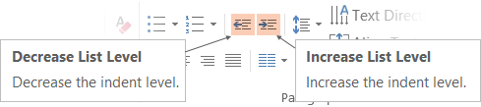
Text with bullet points - adjusting list levels
Main topic 1: size 36pt
Size 28pt for second level
Size 24pt for third level
Size 22pt for fourth level
Size 22 for fifth level
Use the “Decrease List Level” and “Increase List Level” tools on the Home Menu to change text levels.
Try this:
Place your cursor in any row of text to the left that says “Size 20pt for subtopics”
Next click the Home tab, and then on the “Decrease List level” tool. Notice how the line moves up one level.
Now try placing your cursor in one of the “Main topic…” lines of text. Click the “Increase List Level” tool and see how the text is pushed in one level
Use these 2 tools to adjust your text levels as you work

Slide 73
Bullet points layout with subtitle Subtitle is smaller in the same text block
Example of a bulleted slide with a subhead
Set the slide title to “Sentence case”
Set subheads to “Sentence case”
Hyperlink style
www.microsoft.com

Slide 74
Photo layout 1

Slide 75
Demo

Slide 76
Video

